Slide 1
Web Application Testing www.romstal.ro

Slide 2

Agenda
App Description
Testing Approach
Testing Tools Used
Testing Types Covered
Test Cases Overview
Test Cases Results
Bugs Overview
Conclusions

Slide 3

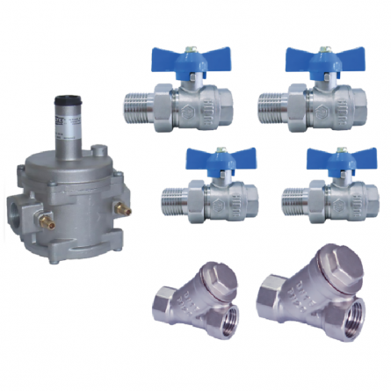
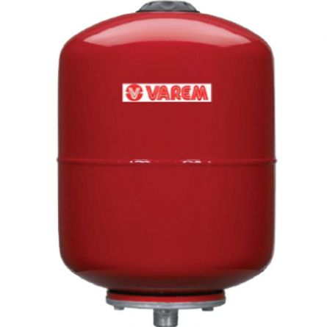
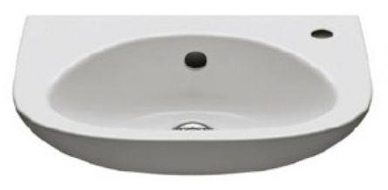
APP DESCRIPTION
www.romstal.ro
Web application
Online store for Sanitary Equipment and Instalations

Slide 4

TESTING APPROACH
Ad-hoc Testing to decide if the application is worth further testing
Exploratory Testing for main functionalities
Document the Exploratory Testing and write down the defects so they can be replicated
Create Test Cases based on Functional/Non-functional requirements (Component Testing, Security, Compatibility, Usability, Performance and UI Testing)
Executing Test Cases and Logging Defects
Focus where bugs were identified, more testing for that area
Write the Smoke tests and execute them
Write the Test Report

Slide 5









TOOLS USED
Mantis Bug Tracker – Bug Reporting
TestLink – Test Case Management
Snipping Tool – Screenshots Capture
Mailinator – Test Emails
Xmind Tool – Mind Maps

Slide 6

TESTING TYPES
A total of 225 test cases designed for this session and 224 (99.55%) were executed.
Functional Testing
Exploratory Testing
Negative Testing
Positive Testing
Smoke Testing
Compatibility Testing
UI Testing
Usability Testing
Performance Testing
Security Testing
PERFORMED
APPLICABLE

Slide 7
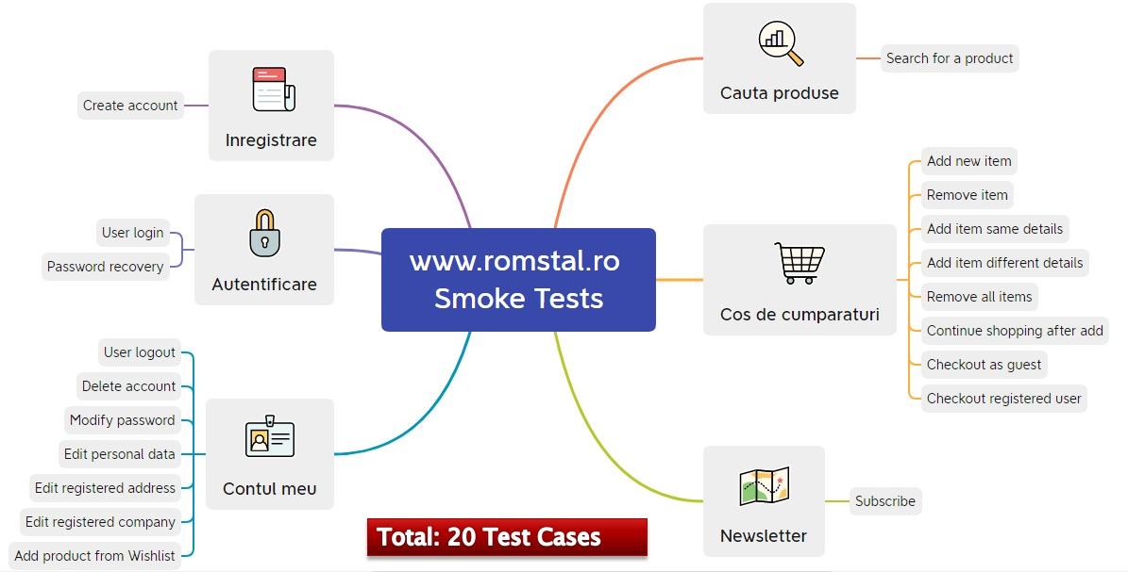
TEST CASES OVERVIEW
Out of a total of 225 test cases, 20 (9%) test cases were selected to form the Smoke Suite.
Total: 20 Test Cases

Slide 8
TEST CASES RESULTS
Functionalities | Status
 | Pass % | No of tests | Passed | Failed | Blocked | Not tested | Defects
Inregistrare | 77.14% | 35 | 27 | 8 | 0 | 0 | 0040997, 0040998, 0040999, 0041002, 0041003, 0041004, 0041005, 0041006.
Autentificare | 100.00% | 25 | 25 | 0 | 0 | 0
Contul meu | 97.50% | 40 | 39 | 0 | 0 | 1 | 41016
Cauta produse | 100.00% | 10 | 10 | 0 | 0 | 0
Cos de cumparaturi | 96.67% | 30 | 29 | 1 | 0 | 0 | 41013
Homepage | 100.00% | 30 | 30 | 0 | 0 | 0
Newsletter | 100.00% | 5 | 5 | 0 | 0 | 0
Compatibility | 100.00% | 10 | 10 | 0 | 0 | 0
Security | 80.00% | 5 | 4 | 1 | 0 | 0 | 41015
UI | 100.00% | 5 | 5 | 0 | 0 | 0
Usability | 100.00% | 5 | 5 | 0 | 0 | 0
Performance | 100.00% | 5 | 5 | 0 | 0 | 0
Exploratory Testing | NA | NA | NA | NA | NA | NA | 0041018, 0041019, 0041022, 0041024, 0041026, 0041029, 0041027, 0041031, 0041035.
OVERALL RESULTS | 95.94% | 205 | 194 | 10 | 0 | 1 | 20

Slide 9
BUGS OVERVIEW
Total: 20 Bugs

Slide 10

CONCLUSIONS
20 Test Cases were executed to test the happy flows:19 passed and 1 not tested
20 bugs identified:2 critical, 10 major, 6 normal and 2 minor
Most of the bugs were identified by performing Exploratory Testing and Negative Testing
Data type used during testing: Blank, Valid, Invalid, Big Data
Fixing at least the major severity
bugs is recommended

Slide 11


LESSONS LEARNED
Finding defects was the main challenge
Lack of requirements
Using too much invalid data in production
Keep the bug reporting and test cases steps and results easy
to follow
Exploratory Testing facilitates learning of functionalities
From user perspective the site can be used for its intended purpose
Less is more,
simple steps are
better to use for
writting test cases
or reporting bugs
Challenges
Lessons

Slide 12



THANK YOU

